Slide 1
PERIODIC CLASSIFICATION OF ELEMENTS PART 2: MANDALEEVE’S PERIODIC TABLE
CHAPTER 5

Slide 2
Mandaleeve’s Periodic Table
The classification of elements is based on the formulae of hydrides and oxides formed by an element.
Notes:
Slide: 11
Welcome back.
In the previous video we have discussed about the working of dobereiner’s traid and newland’s law of octaves.
Now, we will be discussing about Mandeleeve’s Periodic table in detail.
The base of Mandeleeve’s work was based on hydrogen and oxygen as they were the most reactive. This was created when only 63 elements were known. The formulae of hydrides and oxides that were formed by an element is treated as a classification criteria for the classification of Mandaleeve’s periodic table.

Slide 3
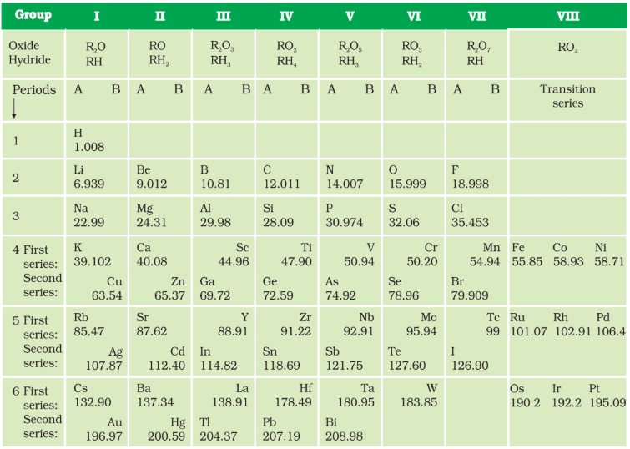
Notes:
Slide: 12
This is mandaleeve’s periodic table
Here, the vertical columns are called groups
and the horizontal columns are called periods
As you can see, there are a few gaps left in the table.
As we mentioned earlier, this table was created when only 63 elements were known. When a few elements are not satisfying the order, Mandeleeve assumed that it is because an element that is not found yet would occupy that place. He also assumed that unknown element’s properties and created the table accordingly.

Slide 4
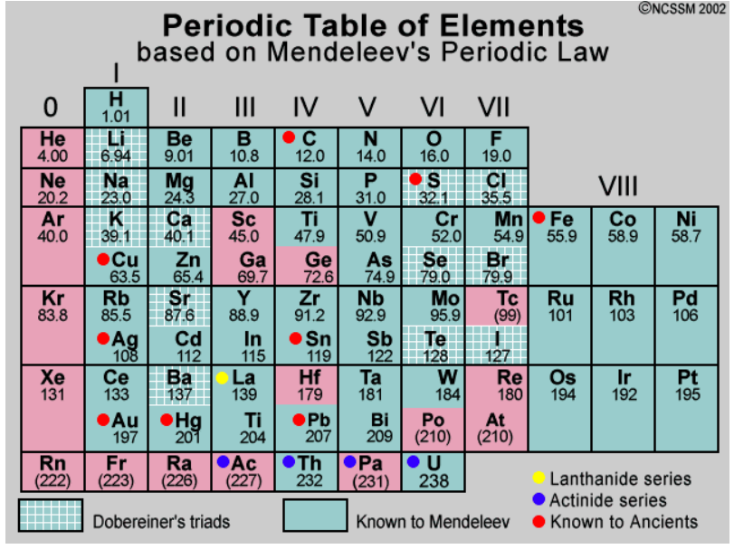
Notes:
Slide: 13
In later days, after more elements were found, they were able to perfectly fit into the Mandeleeve's table
The elements in blue were the elements known to Mandeleeve and the elements in pink were the elements that were discovered later but which perfectly fit the spaces.

Slide 5
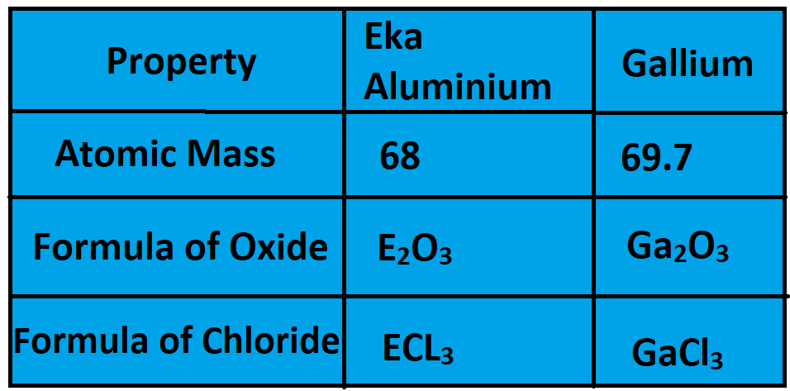
Notes:
Slide: 14
For example, the elements like scandium, gallium and germanium that were discovered AFTER (stress that word) the table was created, have properties similar to eka-boron, eka-aluminum, and eka-Gallium.
Here, Eka-boron corresponds to Scandium, Eka-Aluminum corresponds to Gallium, and Eka-Gallium corresponds to Germanium. This prediction of Mandaleeve helped future scientists to use this table as a base to create the periodic classification of table, that is currently in use.
There were a few cases in Mandaleeve’s periodic table where elements with slightly higher atomic masses are placed in front of the elements with atomic lower atomic masses.
The atomic mass of cobalt is 58.9
The atomic mass of Nickel is 58.7
This is done to group elements of similar properties together, even though it doesn’t follow the sequence.

Slide 6
Drawbacks
No proper place for hydrogen was given.
Isotopes were a challenge
Number of elements between two elements were unpredictable.
Notes:
Slide: 15
The drawbacks associated with manadaleeve’s periodic table will be discussed in this section.
Similar to Newlands’ octaves, Mandaleeve couldn’t assign a proper position for hydrogen.
The isotopes could not be placed anywhere.
The number of elements between two elements could not be predicted. As we saw, Mandaleeve left a few gaps in his table to make space for a few elements. But he could not predict how many elements could come between two elements.
Due to all these drawbacks, the modern periodic table was introduced and we will be talking about it in the next video

